Slide 1
oneM2M SDT and its usage in a typical vertical industry
Prof. Han, Andrew Min-gyu
(andyhan@hansung.ac.kr)
oneM2M TDE WG Chair, HANSUNG University

Slide 2
Introduction of SDT
SDT: Smart Device Template
To find consensus amongst various SDOs and industry alliances to derive a common approach for device modeling. oneM2M and partners have the approach to agree on a set of automation functionalities, following a common syntax, which are sufficient to model most device functions.
The key goals of the SDT are:
keep it simple, especially for manufacturers to contribute device information
modularity for functions and device types
make it easy for developers to create unified APIs
be independent of underlying LAN technologies and protocols
enable extendibility of the system in place without service interruption
allow a pass-through mechanism to enable use of proprietary or technology-specific functions.

Slide 3
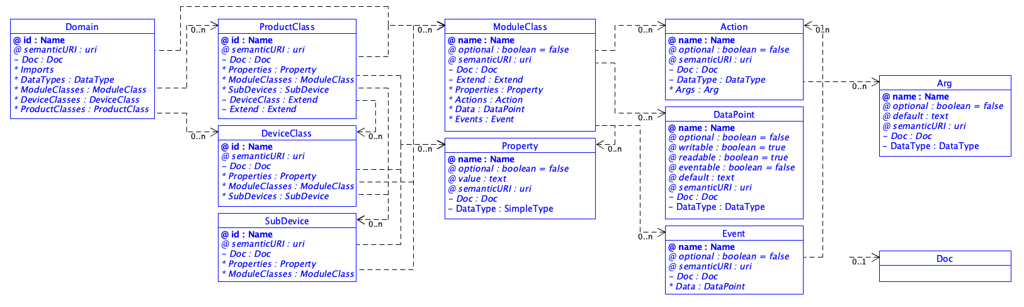
SDT Overview
SDT 4.0 – Basic Elements

Slide 4
SDT Overview
Term | Definition
Domain | Unique name, or "wrapper" which acts like a namespace, set by the organization, company, or project creating the template, allowing reference to a package of definitions for the contained ModuleClasses and device definitions. Can be referenced when extending Products, ModuleClasses, and data types. It has two possible uses: to select the scope of a technology domain, or to set the scope of a use case domain (like Home, SmartGrid, etc)
ProductClass | A concrete device model with deterministic device Properties and ModuleClasses, without optionality. It is deemed as a specialized implementation of a DeviceClass that can be manufactured.
DeviceClass | A physical, addressable, identifiable appliance, sensor, or actuator.
Sub-Device | A device (usually one of several) which may be embedded in or attached to a (full) device. It is not designed to be operated as a standalone device.
ModuleClass | Specification of a single service with one or more service methods, the involved abstracted data model and related events. The expectation is that each separate service which may be used in many kinds of devices (like PowerON/OFF, Open/Close, ...) will be described by a ModuleClass which can be re-used in many DeviceClass or ProductClass definitions.

Slide 5
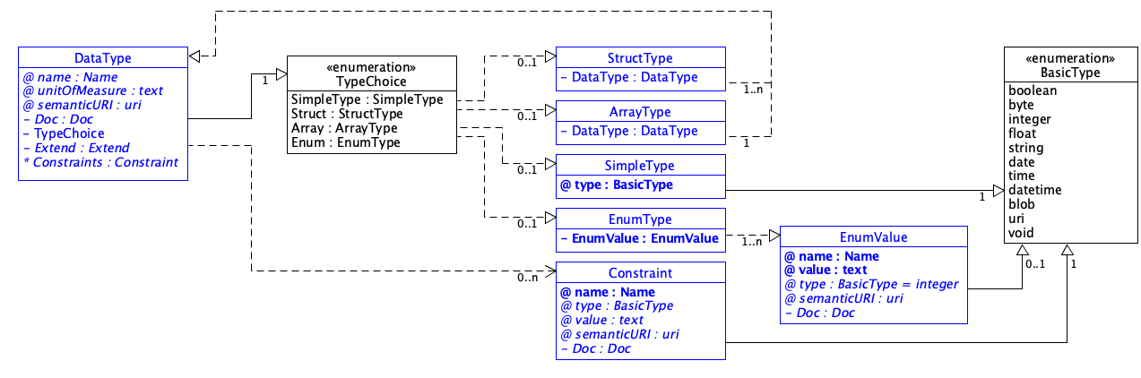
SDT Overview
SDT 4.0 – Data Type

Slide 6
SDT in oneM2M and non-oneM2M interworking

Slide 7
SDT usage in vertical industry – City domain example
deviceOutdoorLamp
Module Instance Name | Module Class Name | Optional | Description
binarySwitch | binarySwitch | false | See clause 5.3.1.12.
brightness | brightness | true | See clause 5.3.1.17.
motionSensor | motionSensor | true | See clause 5.3.1.54.
airQualitySensor | airQualitySensor | true | See clause 5.3.1.6.
uvSensor | uvSensor | true | See clause 5.3.1.92.
timer | timer | true | See clause 5.3.1.90. The timer is used to set duration of giving lights from the moment of triggering by the “brightness” module or “motionSensor” module.
faultDetection | faultDetection | true | See clause 5.3.1.34.

Slide 8
SDT usage in vertical industry – City domain example (cont’d)
Actions of binarySwitch ModuleClass
DataPoints of binarySwitch ModuleClass
Return Type | Name | Argument | Optional | Documentation
none | toggle | none | true | Toggle the switch.
Name | Type | R/W | Optional | Unit | Documentation
state | xs:boolean | RW | false |  | The current status of the binarySwitch. "True" indicates turned-on, and "False" indicates turned-off.

Slide 9
SDT usage in vertical industry – City domain example (cont’d)
DataPoints of brightness ModuleClass
DataPoints of motionSensor ModuleClass
Name | Type | R/W | Optional | Unit | Documentation
brightness | xs:integer | RW | false | pct | The status of brightness level.
Name | Type | R/W | Optional | Unit | Documentation
alarm | xs:boolean | R | false |  | The detection of the motion occurrence.
silentTime | xs:integer | RW | true | s | The time that a motionSensor restrains from sending an alarm in case continous motions are detected after one alarm is produced. This data point can be used to avoid repeated alarm reports.
sensitivity | xs:integer | RW | true |  | The level of the detection accuracy of the motion sensor. This data point can be used to control the number of the report.

Slide 10
SDT usage in vertical industry – City domain example (cont’d)
DataPoints of airQualitySense ModuleClass
Name | Type | R/W | Optional | Unit | Documentation
monitoringEnabled | xs:boolean | R | true |  | The current status of monitoring. "True" indicates enabled, and "False" indicates not enabled.
pm1 | xs:integer | R | true | µg/m³ | The concentration of particle matter under 1㎛.. The minimum value is 0.
pm25 | xs:integer | R | true | µg/m³ | The concentration of particle matter under 2.5㎛. The minimum value is 0.
pm10 | xs:integer | R | true | µg/m³ | The concentration of particle matter under 10㎛. The minimum value is 0.
tsp | xs:float | R | true | µg/m³ | Total suspended particle.
odor | xs:integer | R | true | OU/m³ | The concentration of odor that reflects air pollution. The minimum value is 0.
humidity | xs:float | R | true | pct | The measured humidity. The minimum value is 0, and the maximum value is 100.
temperature | xs:float | R | ture | °C | The current temperature
airPressure | xs:float | R | ture | KPa | The air pressure.
co | xs:float | R | true | mg/m³ | This value indicates the CO level.
co2 | xs:float | R | true | mg/m³ | This value indicates the CO2 level.
ch2o | xs:float | R | true | µg/m³ | This value indicates the CH2O level.
voc | xs:float | R | true | ppm | This value indicates the VOC (Volatile Organic Compounds).
no2 | xs:float | R | true | µg/m³ | This value indicates the concentration of NO2.
so2 | xs:float | R | true | µg/m³ | This value indicates the concentration of SO2.
o3 | xs:float | R | true | µg/m³ | This value indicates the concentration of O3.
noise | xs:float | R | true | dB | This value indicates the level of noise.
windDirection | xs:float | R | true | deg | The wind direction. The value range is [0-359]. North is 0.0 degrees, east is 90.0 degrees, south is 180.0 degrees, west is 270.0 degrees.
windSpeed | xs:float | R | true | m/s | The wind speed

Slide 11
SDT usage in vertical industry – City domain example (cont’d)
DataPoints of brightness ModuleClass
DataPoints of motionSensor ModuleClass
Name | Type | R/W | Optional | Unit | Documentation
brightness | xs:integer | RW | false | pct | The status of brightness level.
Name | Type | R/W | Optional | Unit | Documentation
alarm | xs:boolean | R | false |  | The detection of the motion occurrence.
silentTime | xs:integer | RW | true | s | The time that a motionSensor restrains from sending an alarm in case continous motions are detected after one alarm is produced. This data point can be used to avoid repeated alarm reports.
sensitivity | xs:integer | RW | true |  | The level of the detection accuracy of the motion sensor. This data point can be used to control the number of the report.

Slide 12
SDT usage in vertical industry – City domain example (cont’d)
DataPoints of uvSensor ModuleClass
Actions of timer ModuleClass
Name | Type | R/W | Optional | Unit | Documentation
uvValue | xs:float | R | false | mW/cm²
uvStatus | hd:enumUvStatus | R | true |  | The “uvStatus” indicates the level of the UV radiation status (see clause 5.6.35).
Return Type | Name | Argument | Optional | Documentation
none | activateClockTimer | None | true | Activate current clock timer.
 | deactivateClockTimer | None | true | Deactivate current clock timer.

Slide 13
SDT usage in vertical industry – City domain example (cont’d)
DataPoints of timer ModuleClass
Name | Type | R/W | Optional | Unit | Documentation
referenceTimer | xs:integer | R | true |  | A timer (for example. a time-based value, App Defined Epoch, Progressive) expressed in seconds. The value indicates a time counter to be used as reference for the other time-based data points of this ModuleClass. Usually it is the time since the last event of power-on of the producer (or more in detail the time since the boot of its connectivity node).
targetTimeToStart | xs:integer | RW | true |  | A time span (for example a time-based value, App Defined Epoch, Fixed) expressed in seconds. The value indicates the time when the appliance is expected to start its operation, starting counting from the last ”referenceTimer”.
targetTimeToStop | xs:integer | RW | true |  | A time span (for example a time-based value, App Defined Epoch, Fixed) expressed in seconds. The value indicates the time when the appliance is expected to stop its operation, starting counting from the last ”referenceTimer”.
estimatedTimeToEnd | xs:integer | R | true |  | A timer (for example a time-based value, App Defined Epoch, Progressive) expressed in seconds. The value indicates the time to the end of an appliance’s operations. It is calculated at runtime by the device itself during the execution of its operation.
runningTime | xs:integer | R | true |  | A timer (for example a time-based value, App Defined Epoch, Progressive) expressed in seconds. It indicates the time of the current operation. Usually its value is increasing one value per second. It starts counting from 0 when the operation starts and stops counting when the operation ends.
targetDuration | xs:integer | R | true |  | A time span (for a time-based value, App Defined Epoch, Fixed) expressed in seconds. The value indicates a time that represents the target duration of the operation as per user selection.
absoluteStartTime | m2m:timestamp | RW | true |  | An absolute time to specify the start time.
absoluteStopTime | m2m:timestamp | RW | true |  | An absolute time to specify the stop time.

Slide 14
SDT usage in vertical industry – City domain example (cont’d)
DataPoints of uvSensor ModuleClass
Actions of timer ModuleClass
Name | Type | R/W | Optional | Unit | Documentation
uvValue | xs:float | R | false | mW/cm²
uvStatus | hd:enumUvStatus | R | true |  | The “uvStatus” indicates the level of the UV radiation status (see clause 5.6.35).
Return Type | Name | Argument | Optional | Documentation
none | activateClockTimer | None | true | Activate current clock timer.
 | deactivateClockTimer | None | true | Deactivate current clock timer.

Slide 15
SDT usage in vertical industry – City domain example (cont’d)
DataPoints of faultDetection ModuleClass
Name | Type | R/W | Optional | Unit | Documentation
status | xs:boolean | R | false |  | The status of fault detection.
code | xs:integer | R | true |  | The numeric representation of the fault.
description | xs:string | R | true |  | The message representation of the fault.

Slide 16
SDT usage in vertical industry – Railway domain example
deviceHandheldPTTTerminal
Module Instance Name | Module Class Name | Optional | Description
binarySwitch | binarySwitch | false | See clause 5.3.1.12.
audioVolume | audioVolume | false | See clause 5.3.1.8
battery | battery | false | See clause 5.3.1.10.
clock | clock | true | See clause 5.3.1.18.
energyConsumption | energyConsumption | true | See clause 5.3.1.32.
keypad | keypad | false | See clause 5.3.1.49.
operationMode | operationMode | true | See clause 5.3.1.57.
phoneCall | phoneCall | false | See clause 5.3.1.64.
PTTButton | pushButton | false | See clause 5.3.1.69.
runState | runState | true | See clause 5.3.1.75.
signalStrength | signalStrength | true | See clause 5.3.1.78.

Slide 17
SDT usage in vertical industries
Common Domain
ModuleClass: 99
DeviceModel: 15
City Domain
DeviceModel: 7
Health Domain
DeviceModel: 5
Home Domain
DevceiModel: 29
Industry Domain
Vehicular Domain
DeviceModel: 1
Railway Domain
DeviceMode: 2
TS-0023: ‘SDT based Information Model and Mapping for Vertical Industries’ provides
99 ModuleClasses, 59 DeviceModels
for 7 Vertical Domains and will does more!

Slide 18
Thank you!

